Slide 1

Security Scan for OpenStack
Demo 6
13 April 2018
Clara De Paolis
Dilip Makwana
Hao Wu
Chi Zhang

Slide 2

Project Overview (Quick Recap)
About Trilio: provides support for VM backups on OpenStack
Our Project: We are building a tool to scan these backups for vulnerabilities
We have built on an existing tool (vminspect) that uses libguestfs to read the backup images
We use instead the NVD CVE database and provide more details for each vulnerability
Our tool schedules running these scans on all VM images in a workload using Celery and RabbitMQ. Celery master maintains the tasks in a queue, and assigns the tasks to idle workers sequentially.
We save the scanning results in an NFS, users can check the scanning report in a browser
Notes:
Dilip

Slide 3
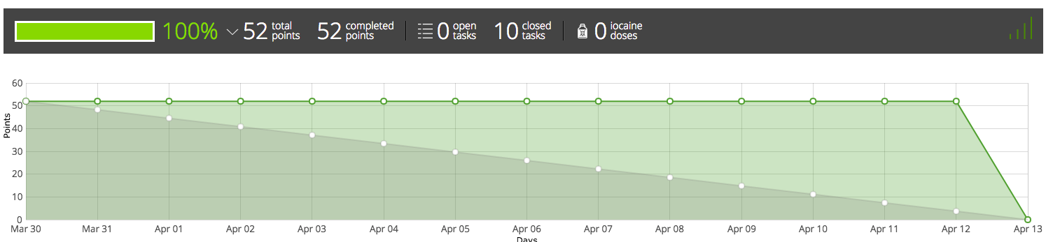
Progress Since Last Demo
Set up environment on Trilio OpenStack
BASH script for managing all client VMs by “one click”
We have deployed our VMs and code to Trilio’s enviroment
Demo our result to our mentor
We have a meeting after this lecture
Visualizing results (Stretch Goal)
Finishing up end-to-end system
We still need to integrate the visualization part
Notes:
Dilip

Slide 4
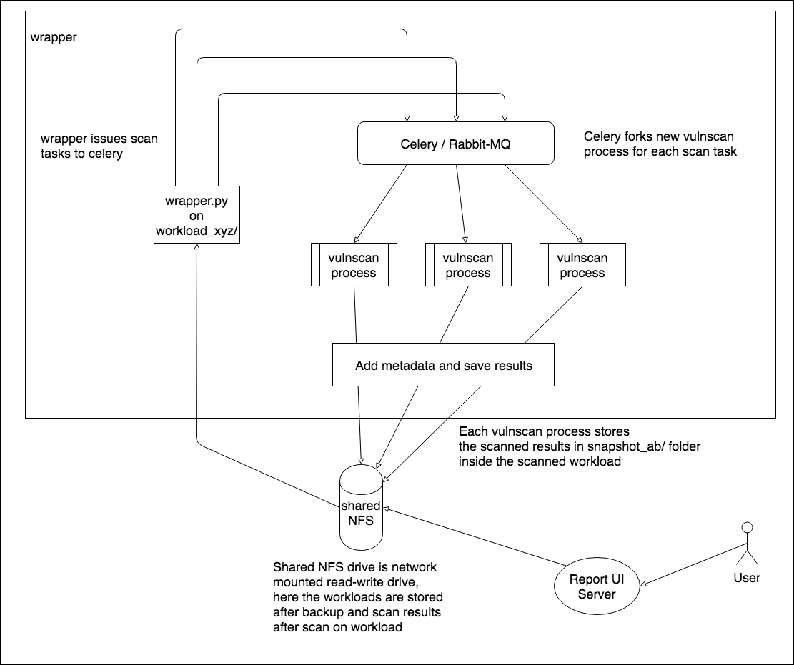
System Diagram
Entire System as a whole
Notes:
Dilip

Slide 5
Simplify the deployment process
For deployment, we need one master VM and several worker VMs.
Manually set up the master VM and one worker VM
Update /etc/rc.local file to run the services (NFS, Celery, RabbitMQ, Django, etc.) automatically during system startup
Create Snapshots for the VMs
For worker deployment, we simply create VMs with the Snapshot
Notes:
Chi

Slide 6
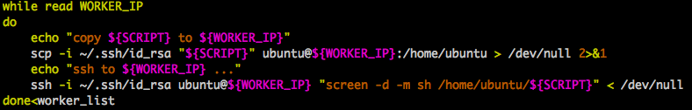
Simplify the management process
For management, we control all the worker VMs from the master.
Maintain the IP of all worker VMs in a “worker_list” file
Write scripts that we want to run on the worker VMs (like restart_celery.sh)
Use a control script to copy and run
Notes:
Chi

Slide 7
Visualize the scanning results
We are now saving the scanning results in JSON format (not intuitive)
Trilio really wanted us to provide a fancy report
Run a Django server on a VM, parse the scanning result and render an HTML page including a table and diagrams to the user
We haven’t shown it to Trilio, may need some change after the meeting
http://128.31.25.222:8000/visual/vulscanRes1/
Notes:
Chi

Slide 8
Researched More on Docker Solution
Alternative to our current Queue Tasks solution (RabbitMQ + Celery)
Each container scans one backed-up image (qcow2 file)
Current challenges
How can we mount NFS to a container
Currently, Mount NFS on the hosted VM and send the path to the container
Trying to use the plugin (Netshare) to mount NFS as a docker volume)
All backup images are on one NFS. The scanning speed is bounded by NFS’s reading speed
Notes:
Hao

Slide 9
Release Schedule
Sprint 7
(Today) Meet with Trilio about integration, their OpenStack environment, and final deliverables
Testing end-to-end system with more diverse images
Polishing our outputs for the end user
Explore more on Docker solution
Record final video
Notes:
Hao

